Slide 1
Traditional Marketing Vs Digital Marketing
1. Wide Reach
2. Niche Marketing
3. Cost Effective
4. Measurement and Tracking
5. Generates Potential Leads
6. Performance Oriented
7. Real Time Results
8. Audience Control
9. Interactivity
10.Fair Play/Equity
Class-III

Slide 2
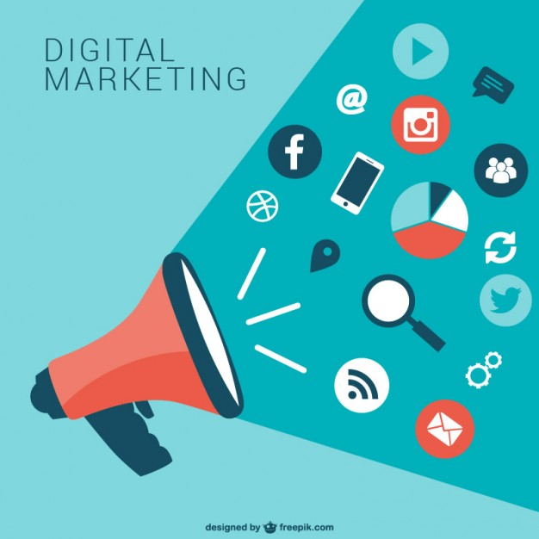
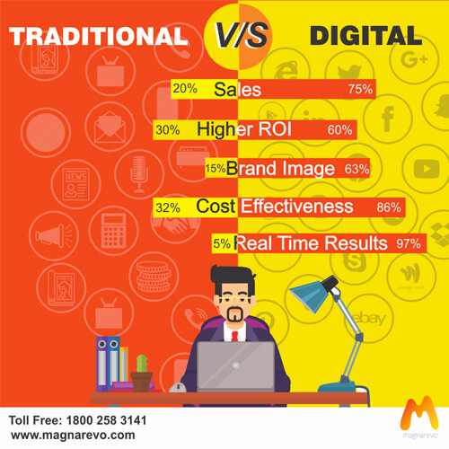

Performance
Return on Investment
https://www.magnarevo.com/traditional-marketing-digital-marketing

Slide 3
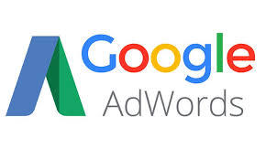


Performance
Possible the measure on investment
Total 500 Customer
50 Customer Converted
Rs 100
Total Sale
Rs 5000
Rs 40
Rs 50
Rs 10
Rs 1900
Rs 2500
Rs 600

Slide 4
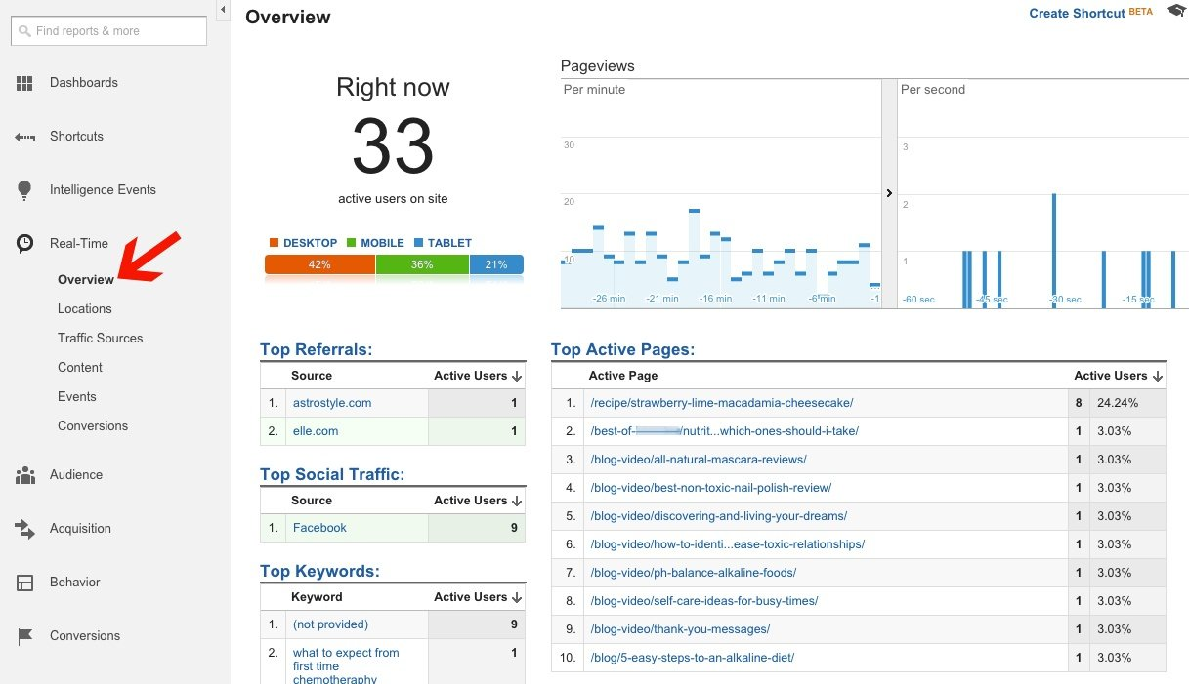
Real Time Analysis
Testing New Tracking Implementations
Monitoring Traffic During Media Attention
Monitoring Website Load for Developers
Setting Up Shortcuts

Slide 5
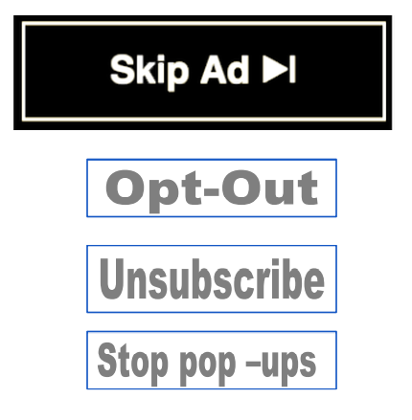
Audience Control
Customization
Personalization
Web Analytics
Organizational Goals
Google Ad Personalization
Variables
Segments
Groups

Slide 6
Interactivity
Digital Marketing
Interactivity
Companies can interact with potential customers or vice versa in real time by using various Modes
Facebook Page
Blog
Comments
Online Reviews
Live Chat
YouTube Channel
Many More

Slide 7


Interactivity
Traditional Marketing

Slide 8

Fair Play
Myths
Big Brands
Small Scale Business
Any business can contend with their competitor irrespective of the size with sound digital marketing strategy and skills of digital marketing

